Slide 1

Introduction to Web Design

Slide 2
What Websites are made of

Slide 3
What Websites are made of

Slide 4
HTML provides the structure of a page
A well-written HTML document should be “understandable” without a stylesheet.

Slide 5
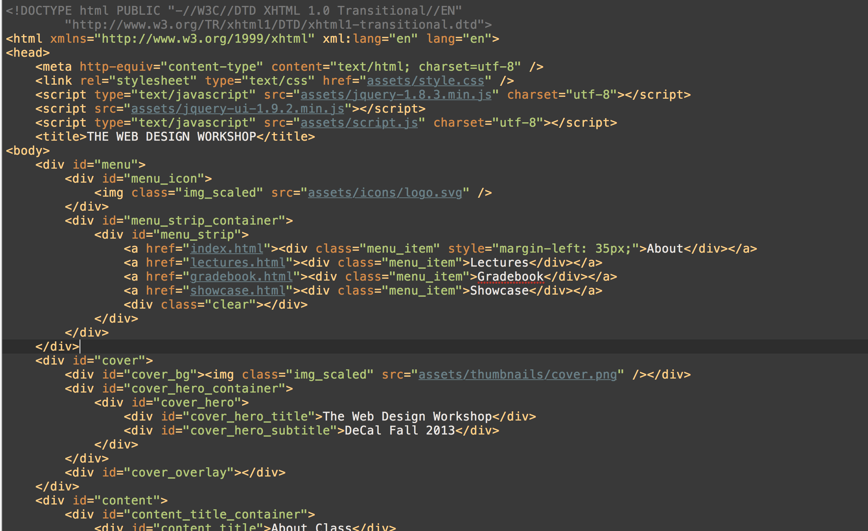

Slide 6
CSS provides the design of a page
Just several lines of “code” is enough to create “design” – shapes, color, buttons, you name it.

Slide 7
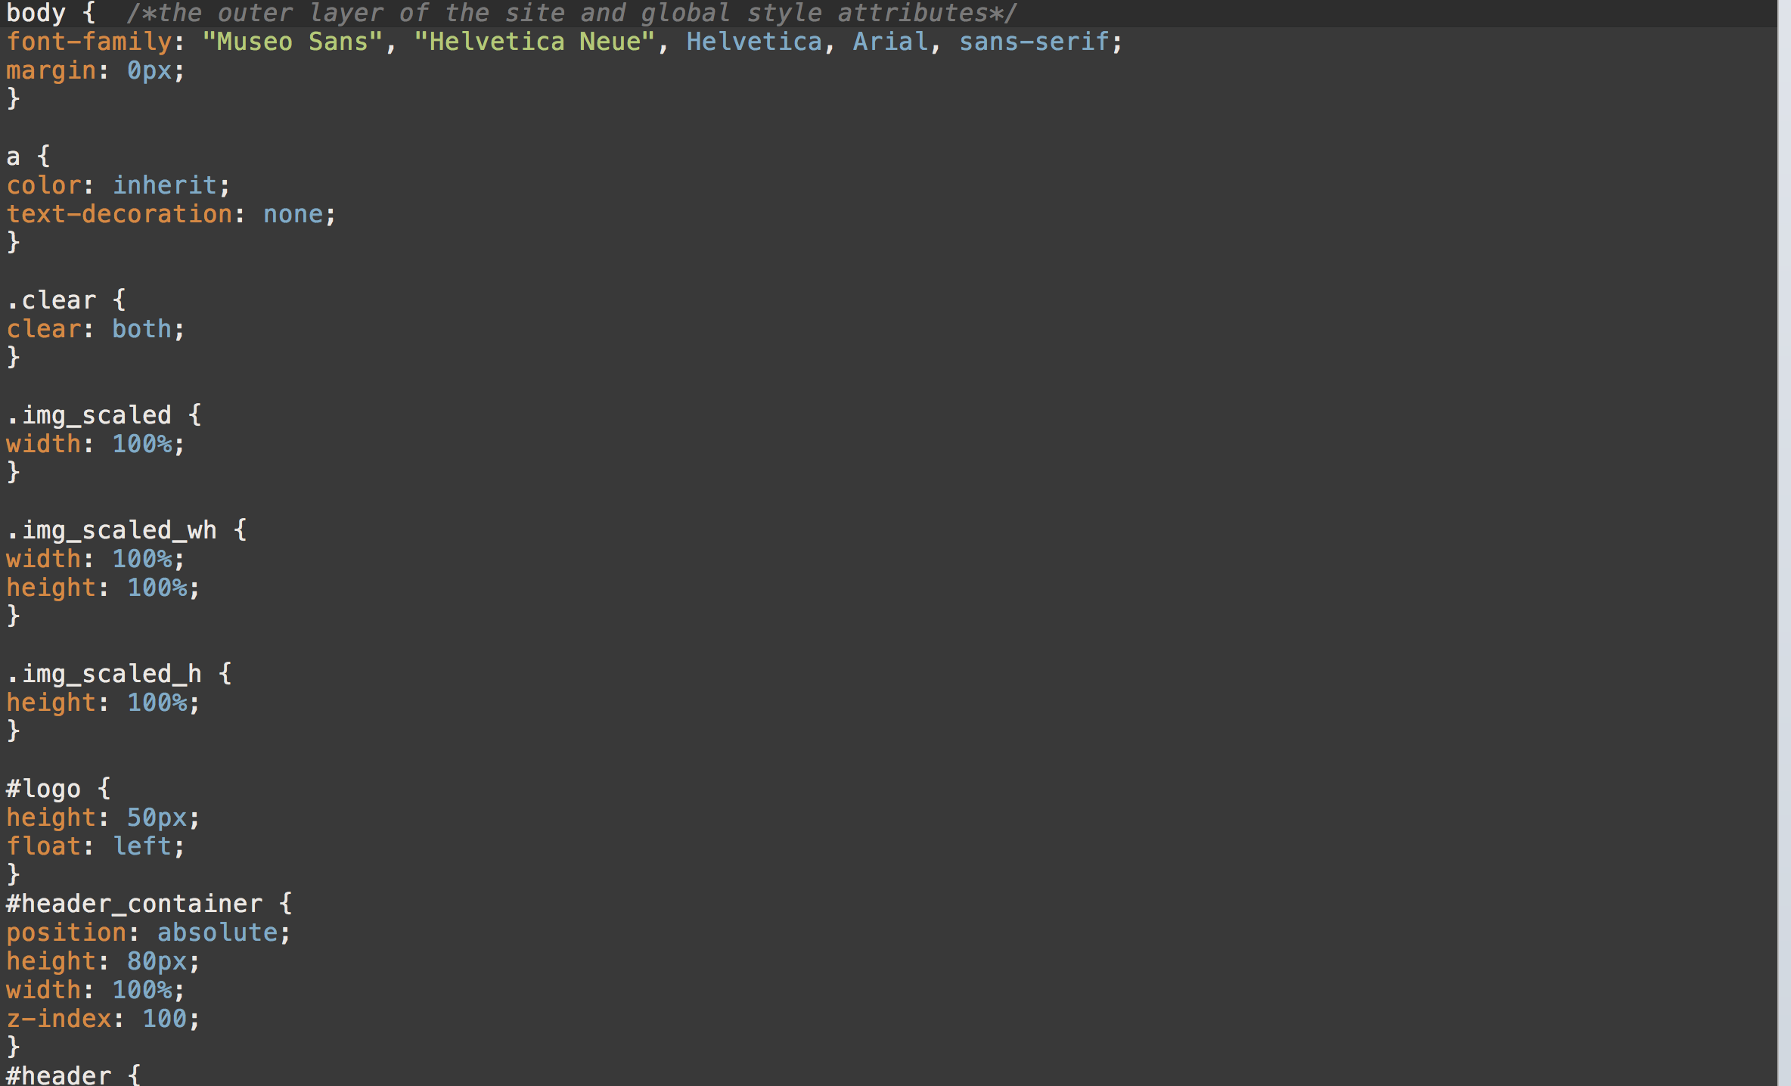

Slide 8
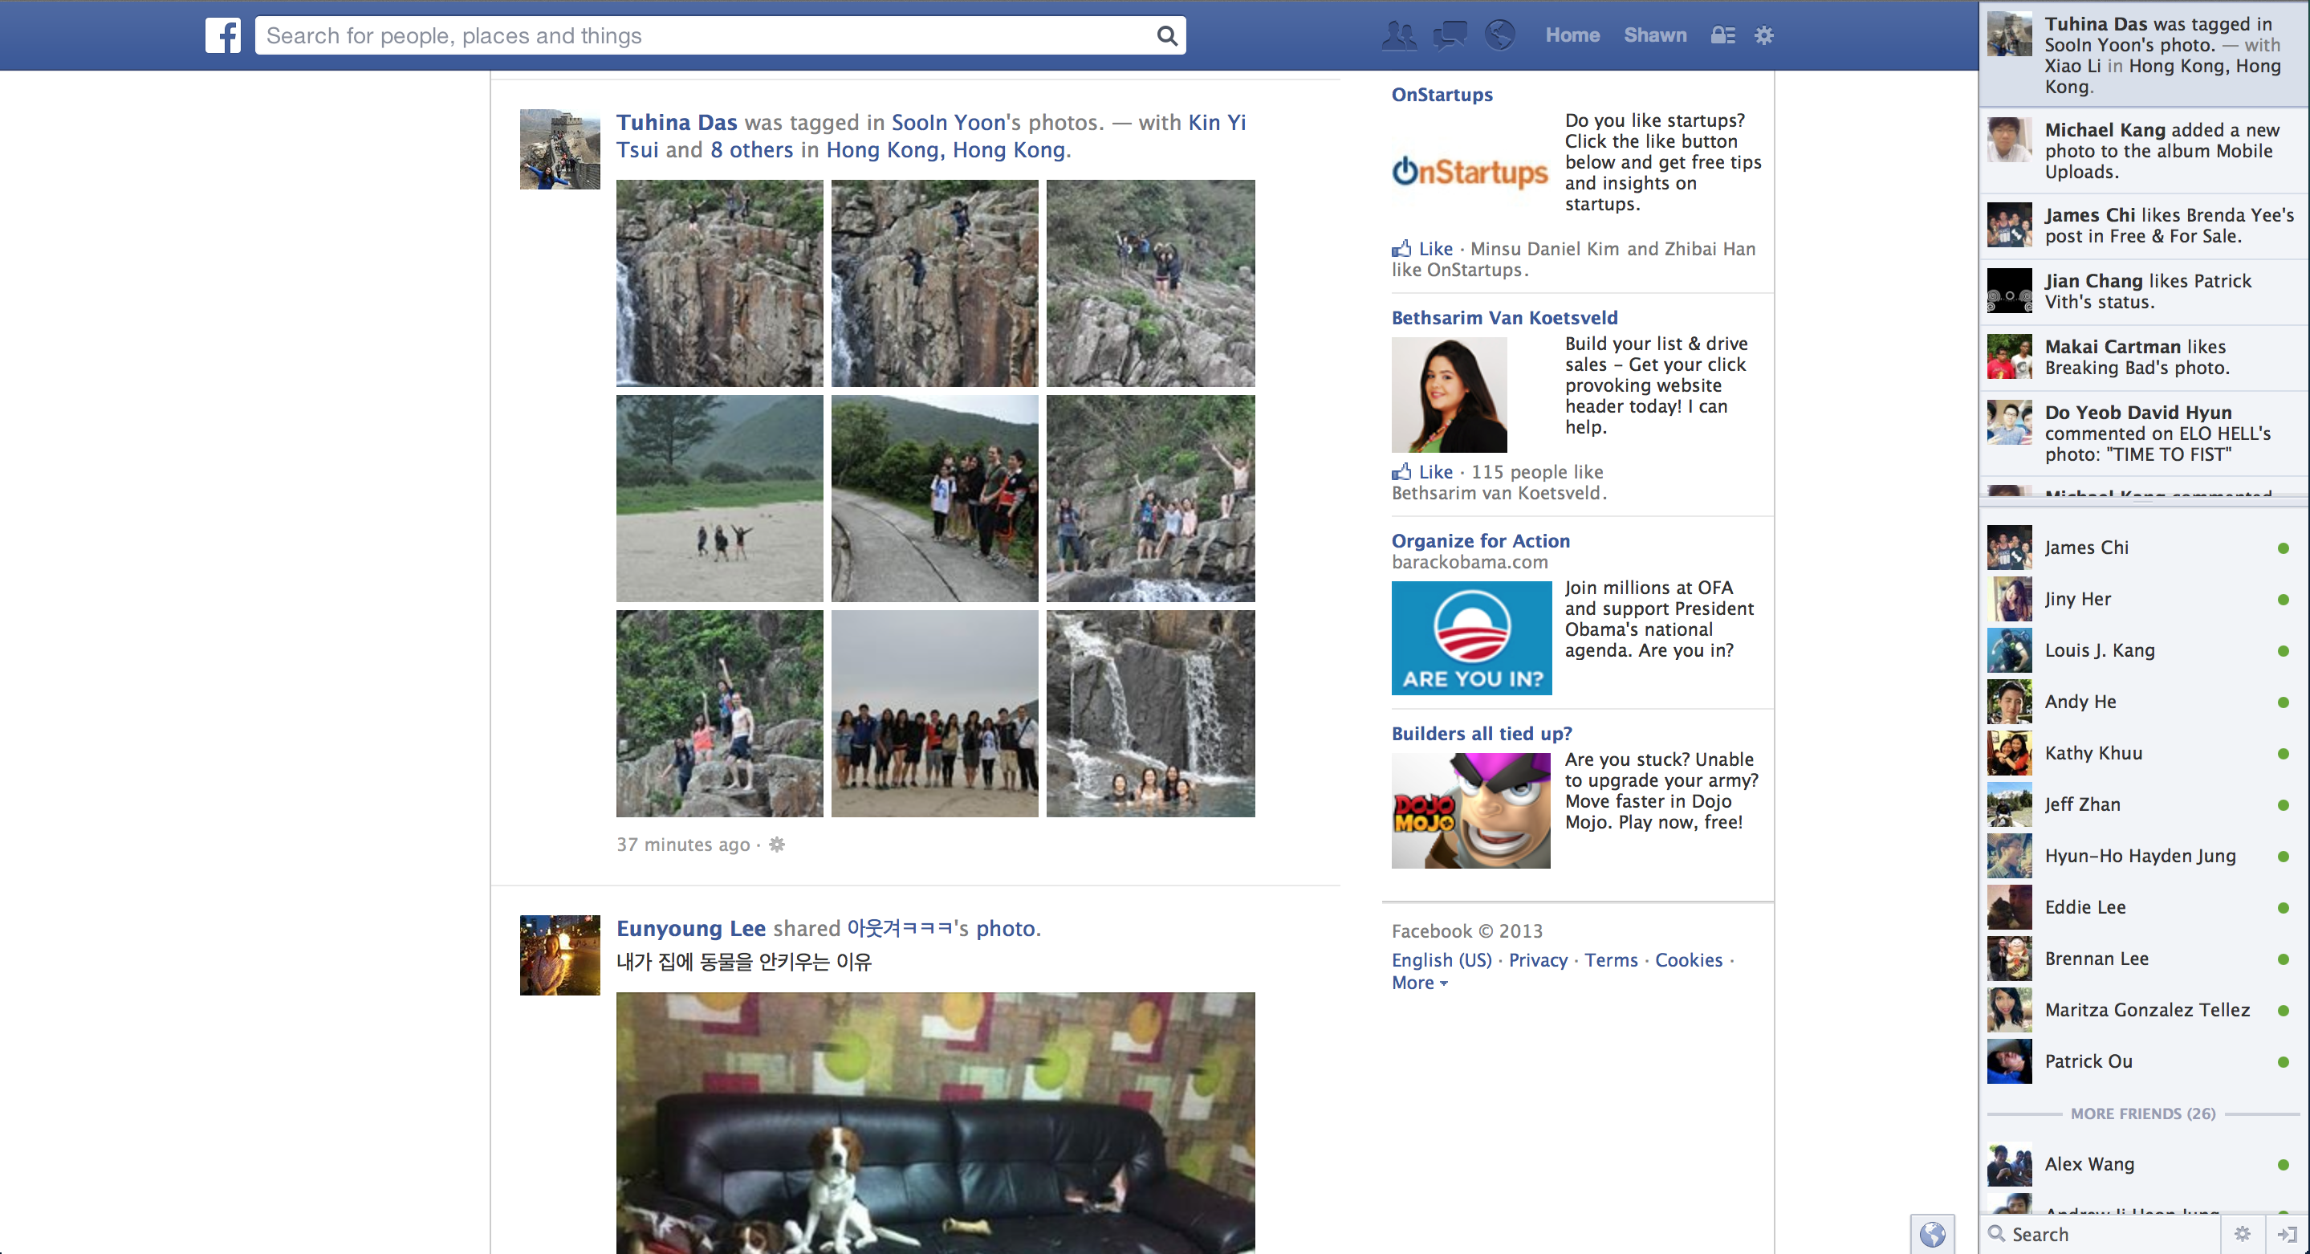

Slide 9
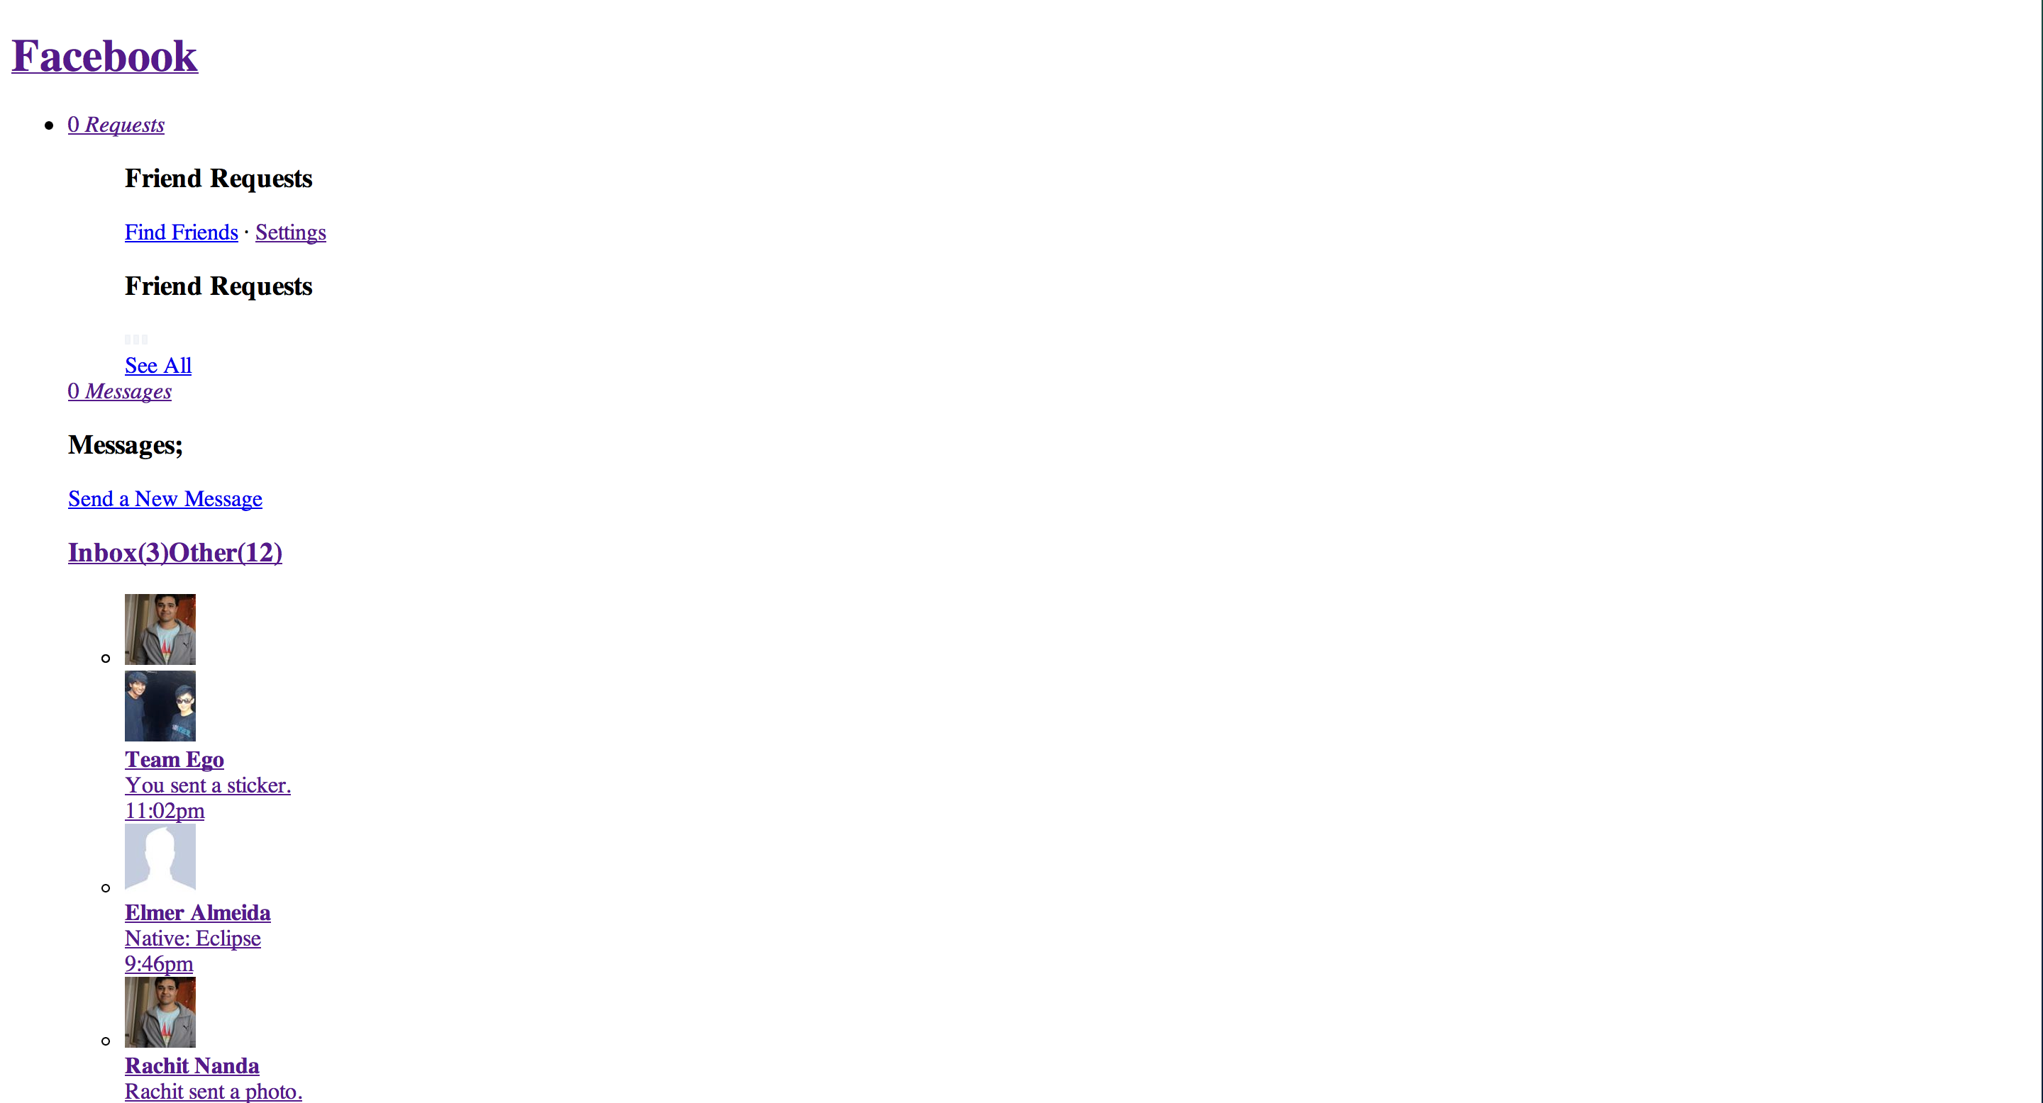

Slide 10
JS provides the function of a page
What will happen to the website with Javascript disabled?

Slide 11
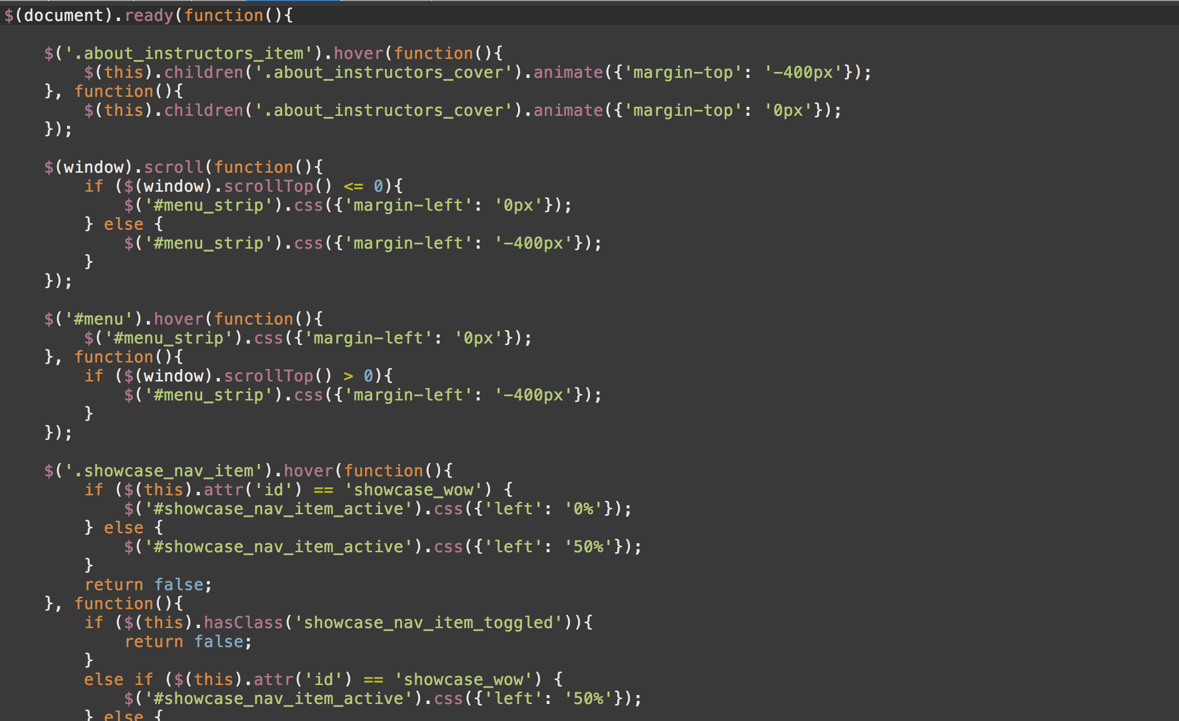

Slide 12
How do I make a Website?

Slide 13
UI Design Workflow

Slide 14
HTML Structure

Slide 15
Tags
Tags start with a left bracket < and end with a right bracket >
This is a paragraph tag: <p>
There are opening tags and closing tags. Closing tags start with </ instead
Example: </p>
Together, a set of tags is called an element
<p></p> is a paragraph element
You can add content between a opening and closing tag
Example: <p>Hello Class!</p>

Slide 16
Tags
Opening tags must have a closing tag
Not acceptable: <p>Hello!
Close it: <p>Hello!</p>
There are exceptions for special tags
Example: <br>
This is a line break tag
Also: <link type=“text/css” rel=“stylesheet” href=“style.css”>
This is a link tag to your css file (we will go over this later)

Slide 17
Basic HTML Structure
All webpages have 3 core elements to them:
HTML tag
Head tag
Body tag
The head and body tags are within the HTML tags
HTML
Head
Body

Slide 18
Basic HTML Structure
All HTML pages must start with the <html></html> tags
This tells the browser to render meaningful HTML code
Inside the HTML tags, put <head></head> tags
<html>
<head>
</head>
</html>
Notice we indented the <head></head> tags. This is for readability purposes (you could put everything in one line too, but we indent to make it easier for us to read)

Slide 19
Basic HTML Structure - Header
What goes in <head></head> ?
Title of page, links to css & javascript files, search engine keywords and description, website info, etc.
Everything not rendered on the page (the content)
Title
<title></title> tags
Defines the title displayed on browser windows/tabs

Slide 20
Basic HTML Structure - Header
<html>
<head>
<title>First Webpage</title>
</head>
</html>

Slide 21
Basic HTML Structure - Body
What goes in <body></body> ?
Content for your page
This is what the viewer sees
Heading Tags
<h1></h1>, <h2></h2>, …, <h6></h6>
6 default heading sizes. 1 is the largest, 6 is the smallest
Paragraph Tags
<p></p>
Adds some space above and below your paragaph

Slide 22
Basic HTML Structure - Body
Other Useful Tags
<br> for a line break (jumps to next line for a text)
<strong>…</strong> for bold text
<em>…</em> for italicized text
<hr> for a single horizontal line

Slide 23
Images & Links

Slide 24
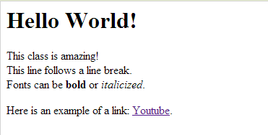
Images & Links
Links
<a>…</a> tags
Also called anchor tags
Example:
<a href=“http://www.youtube.com”>Youtube</a>
href is an example of an element attribute
Attributes are followed by = and “…”, with something in “…”
href needs a url inside the “…”. Can be relative or absolute
Between the <a>…</a> tags is the text displayed on the browser

Slide 25
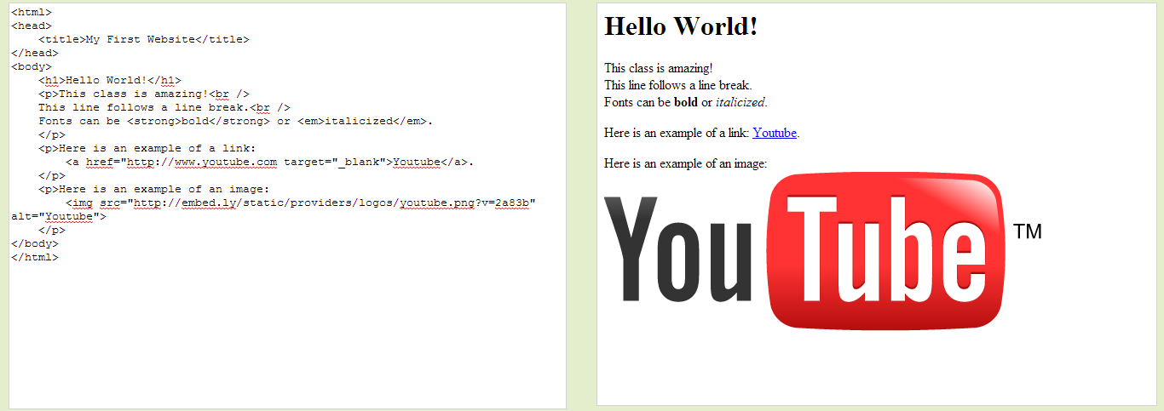
Images & Links
Images
<img> tag
Image tags rely a lot on HTML attributes (like href in anchor tags)
src attribute
Defines the image source (either relative or absolute path)
Example: <img src=“/path/to/filename.png”>
height & width attributes
<img src=“/path/to/filename.png” height=“100” width=“100”>
Note: Number is in # of pixels
alt attribute
Example: <img ... alt=“yo!”>
Displayed if image is unavailable, or is read if using screen reader

Slide 26
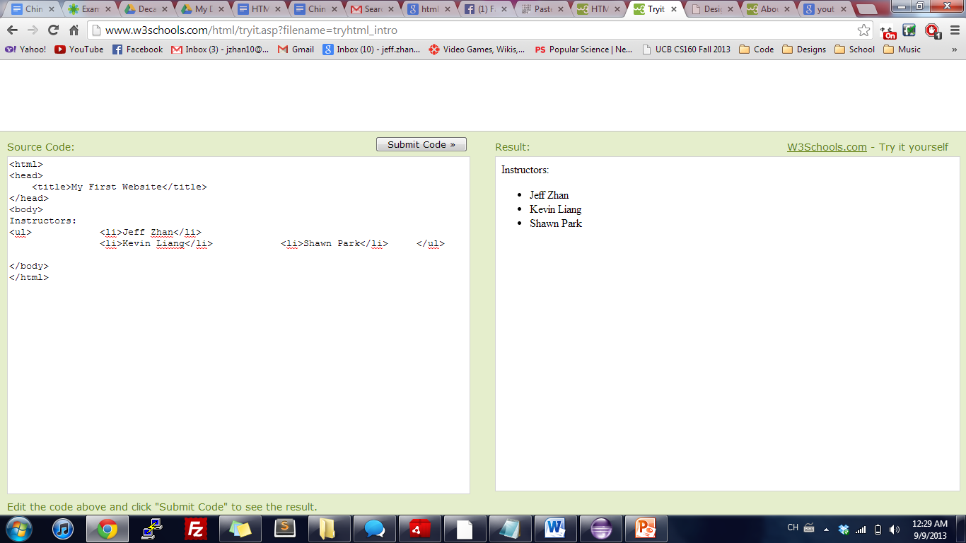

Lists
Unordered Lists (bullets)
<ul> <li>Jeff Zhan</li>
<li>Kevin Liang</li> <li>Shawn Park</li> </ul>
Ordered Lists (numbers)
<ol> <li>Jeff Zhan</li>
<li>Kevin Liang</li> <li>Shawn Park</li> </ol>

Slide 27
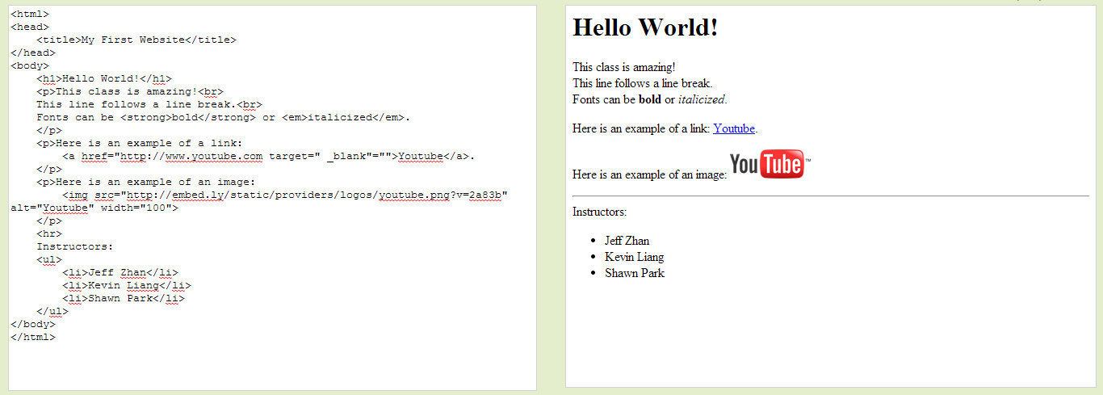
Lists

Slide 28
Hands-on Session 1 My first website

Slide 29
Divs & Spans

Slide 30
Divs and Spans
<div></div> tags are the primary tags we will use from now on
They are essentially tags with no special properties (like <strong> or <h1>)
You customize them with CSS
They are stacked vertically, meaning you cannot have two divs side by side unless you alter the CSS
<span></span> tags are used from time to time
Like a div tag, they have no special properties
You customize them with CSS
They are stacked horizontally, meaning you can have two spans side by side

Slide 31
IDs and Classes

Slide 32
IDs and Classes
IDs and Classes are both attributes to HTML elements
They look like this: <div id=“main-content”> or <p class=“intro”>
IDs
Unique to a single HTML file (no other IDs on page can have the same ID)
Classes
There can be one or more of the same class on a given page
IDs and Classes are important concepts for CSS. This is how CSS will select certain elements and style them

Slide 33
Intro to CSS

Slide 34
Intro to CSS
CSS stands for Cascading Style Sheets
They go in another file with an extension of .css
Link to the CSS file from your HTML file (in the <head></head> tags)
Basic Structure of CSS:
SELECTOR
p { color: red; font-size: 16px; }
PROPERTY
VALUE

Slide 35
Intro to CSS
SELECTOR
p { color: red; font-size: 16px; }
PROPERTY
VALUE
A “selector” can be the HTML element name, its ID name or Class name
It is followed by braces { }, with CSS property-value pairs in between
Properties define a CSS style
They are followed by a colon : and a value
Close property-value pairs with a semicolon ; (important!!)

Slide 36
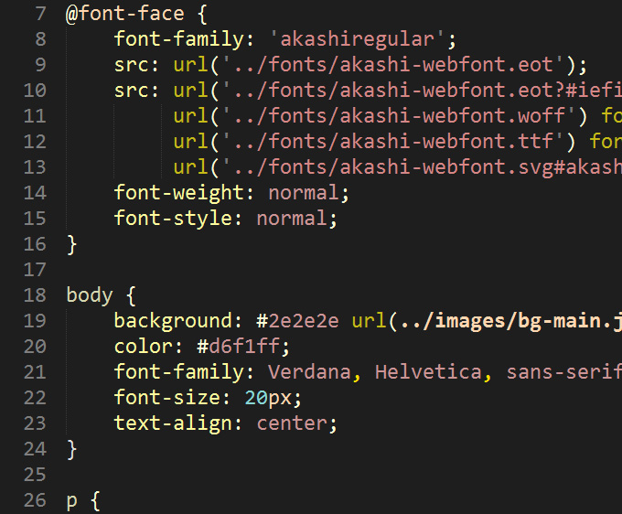
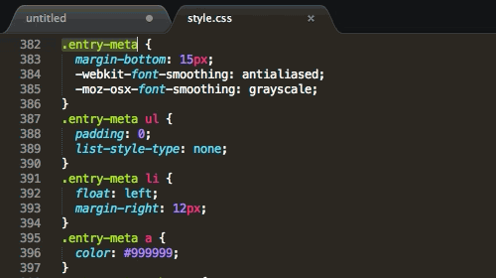
Intro to CSS
Sample CSS Documents

Slide 37
Intro to CSS
Selecting elements to style is simple
Use either the HTML element name, its class or its id
<p>Hello World!</p>
Select this element with p
Style p: p { color: red; }
What if you have multiple paragraphs, but want to style just the first one?
You can use IDs:
<p id=“intro”>Hello World!</p><p>My name is Bob.</p>
Select the ID intro:
#intro { color: red; }

Slide 38
Intro to CSS
Select elements by ID with a pound symbol #
Example: #intro { font-size: 16px; }
Select elements by Class with a dot symbol .
Example: .items { line-height: 26px; }
How would you select “Second Paragraph”? What about both divs?
<div id=“first” class=“paragraph”>
First Paragraph
</div>
<div id=“second” class=“paragraph”>
Second Paragraph
</div>
Answer 1: #second { … }
Answer 2: .paragraph { … }

Slide 39
Linking to CSS

Slide 40
Linking to CSS
3 ways to style CSS
Inline CSS
Internal Stylesheet
External Stylesheet
We will only cover the External Stylesheet, the most commonly used and best way to utilize CSS

Slide 41
Linking to CSS
In your HTML file’s <head></head> tags, include the following line
<link rel=“stylesheet” type=“text/css” href=“/path/to/style.css”>
It is a lot to take in! Thankfully, you can copy this line for all your HTML pages and just change the href attribute to any .css file
Just know this is a <link> tag, linking your HTML page to your CSS file

Slide 42
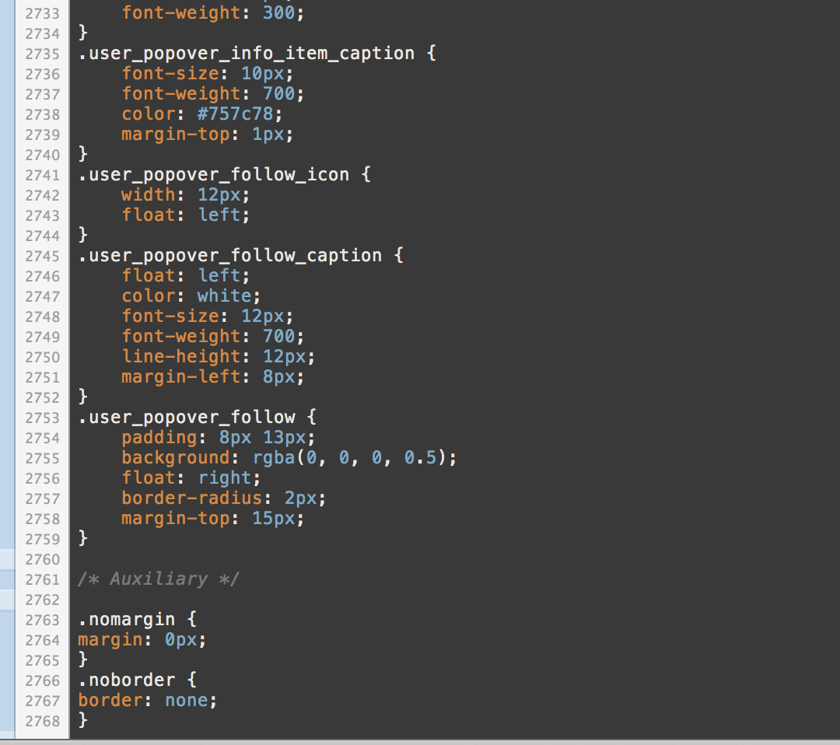
UI Design Workflow
Do I really have to manually type out 2000 lines of CSS?

Slide 43
Web Inspector to the rescue!
Allows you to test your designs in-browser
You can write out CSS rules and see how it looks live
No need to save a file, reload, etc.
Allows you to learn from other people’s work
Other functionalities (for front-end) include:
Autocomplete for CSS rules
Color Picker
Browser Compatibility Test
JS Debugger
3D View (Firefox)

Slide 44
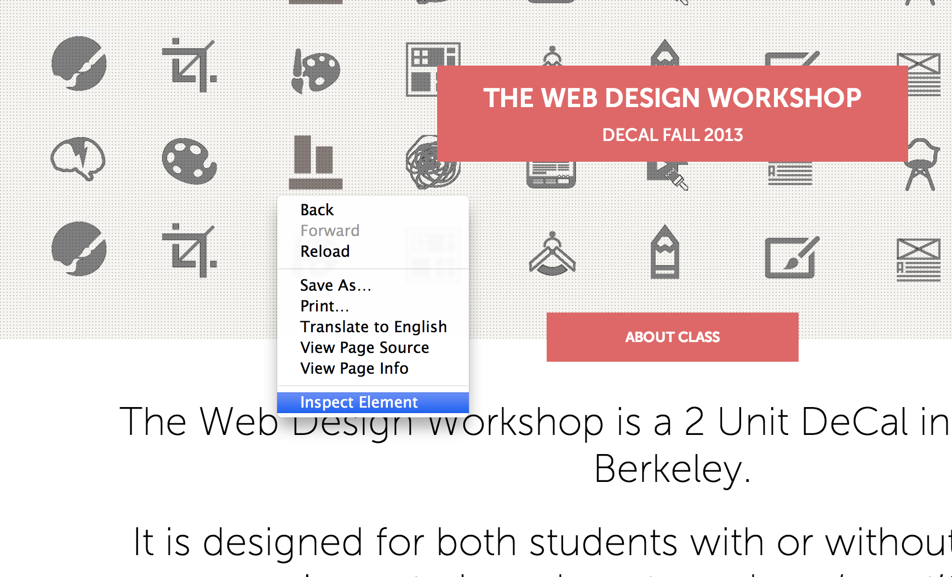
Web Inspector to the rescue!
How to open up Web Inspector

Slide 45
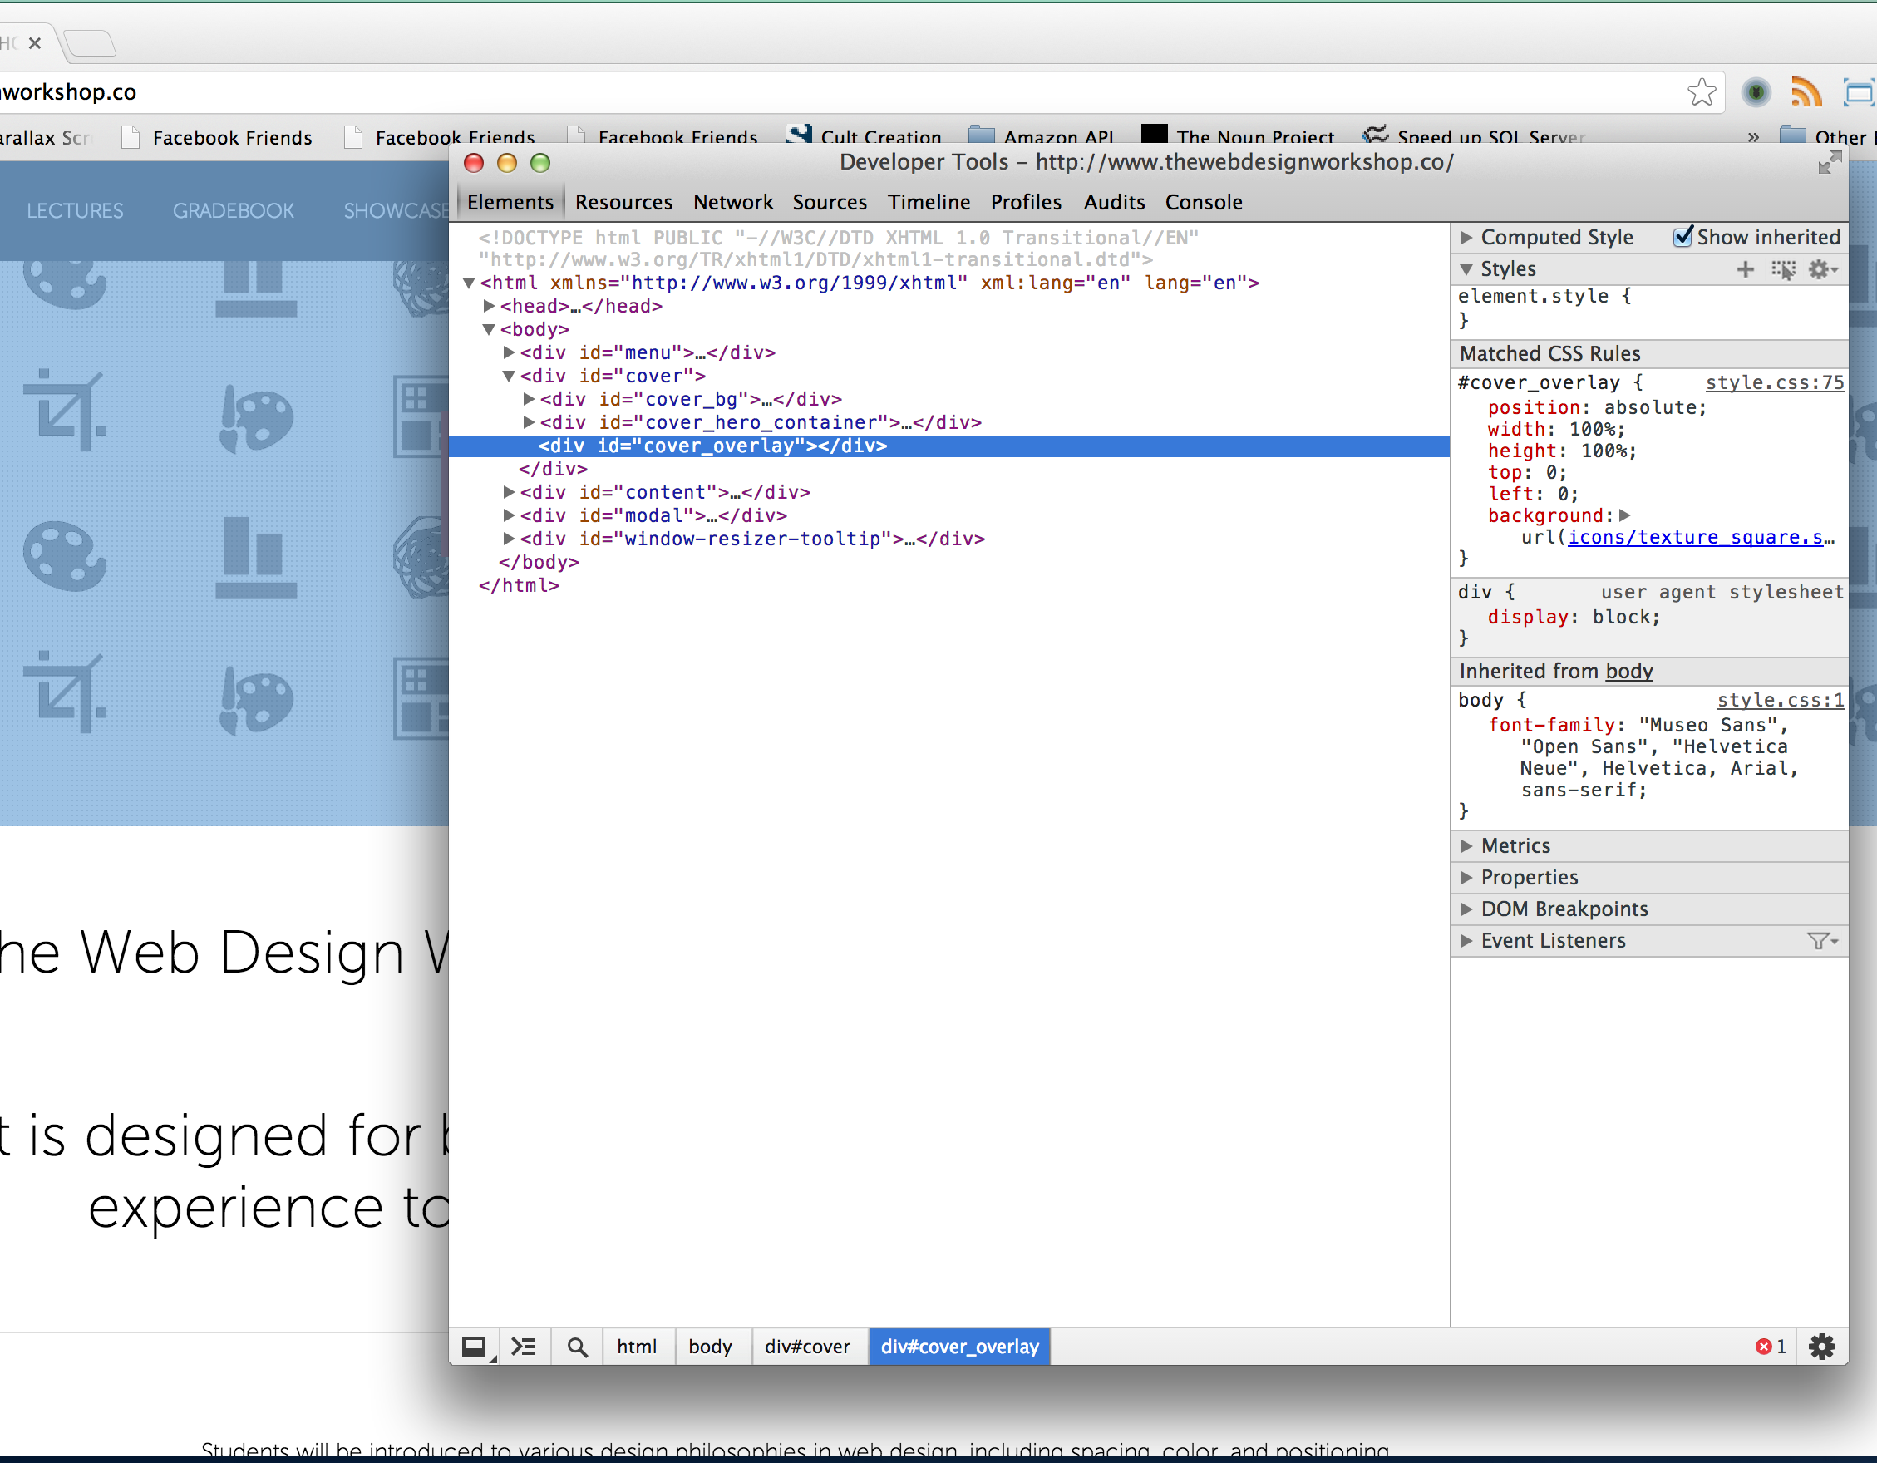
Web Inspector to the rescue!
The selected element is highlighted as Web Inspector opens

Slide 46
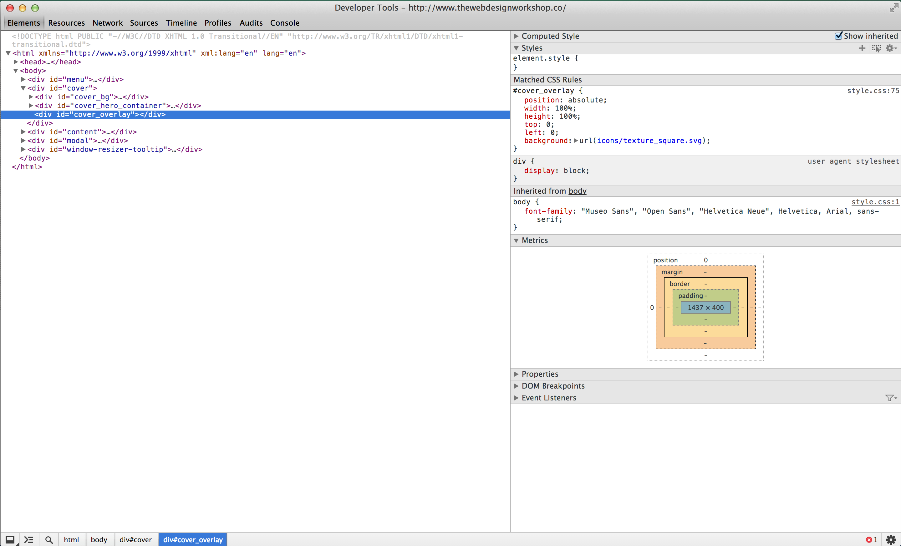
Web Inspector to the rescue!
CSS Editor
Selected Element
Metrics
Elements Tab of the Web Inspector A place for editing web site design on the fly
Notes:
Edit website designs
Peek at other people’s designs
Majority of time here

Slide 47
You will spend as much time on the Web Inspector as you will on the code editor
Try out the code on the Web Inspector before you write it on the Code Editor – It will save you tons of time

Slide 48
Web Inspector Workflow

Slide 49
A Few Caveats about Web Inspector
Changes you made in web inspector are NOT saved automatically
Must make sure changes are saved by:
Going to Resources Tab -> Find your CSS file and copy paste all the code to your CSS file (Modification)
Going to Resources Tab -> Find inspector-style.css and copy paste all the code to your CSS file (Addition)

Slide 50
Hands-on Session 2 Styling my first website

Slide 51

CSS Properties

Slide 52
CSS Properties
There are a lot of properties! We will teach you the most essential
color
Changes the color of your text
Value is either a default color value (red, blue, etc.), RGB or HEX value (we will go over this next week)
background-color
Changes the background color of your HTML element
Value is either a default color value (red, blue, etc.), RGB or HEX value (we will go over this next week)

Slide 53
CSS Properties
text-align
Values: left, center, right, justify
text-decoration
Values: underline, overline, line-through
font-size
Value in px (ex: 16px or 24px)
Other ways to define font too (but we won’t go over them)
font-weight
Values: normal, bold, bolder, or lighter
Or use values from 100, 200, …, to 900
400 = normal, 700 = bold

Slide 54
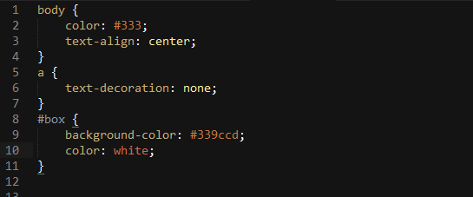
CSS Properties
Sample:

Slide 55
CSS pseudo-classes

Slide 56
CSS pseudo-classes
Adds effects to your selectors
Syntax:
.selector:pseudo-class { …css styles … }
Ex: a:visited { … }, #box1:hover { … }
Common pseudo-classes:
:visited = Links you’ve visited
:active = Links when you click on them (happens in milliseconds)
:hover = When mouse is over element
:focus = When typing in the current <input> tag (we go over <input> tags later on)
Remember :hover! Most likely you will use this the most ;)

Slide 57
CSS pseudo-classes
:hover

Slide 58
CSS pseudo-classes
:active (happens briefly)
Click this Link
Click this Link
:visited
Click this Link

Slide 59
CSS pseudo-classes
:focus
Name:
Name:
Age:
Age:
Year:
Year:
Major:
Major:

Slide 60
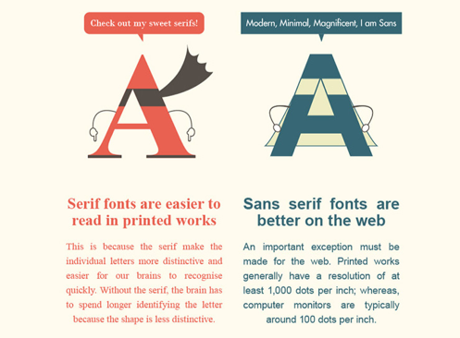
CSS Properties – Font Family
Before we talk about font-family, let’s go over some basics
There are 2 types of fonts: Serif and Sans-serif

Slide 61
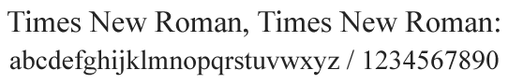

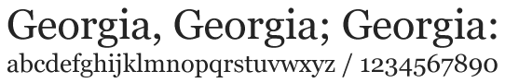
CSS Properties – Font Family
On the web, we call commonly used fonts “web-safe”, meaning all browsers can render the fonts without trouble
Here is a list of web-safe “serif” fonts:

Slide 62
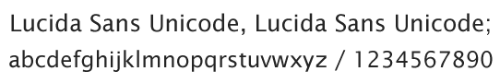
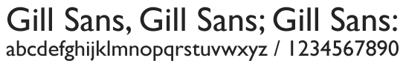
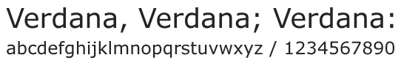
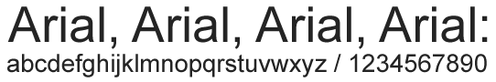
CSS Properties – Font Family
Here is a list of web-safe “sans-serif” fonts:

Slide 63
CSS Properties – Font Family
Let’s see the CSS property for using a font-family
font-family
Example: font-family: Arial;
Usually there are more than one font-family value
Example: font-family: Helvetica, Arial, Verdana, sans-serif;
This means the font-family Helvetica will be used
If Helvetica is not supported by the browser, the next font is used
These are called fallback fonts
The last fallback font in this example is sans-serif (what the browser chooses as the default sans-serif)
If no fallback fonts or no font defined, default serif font used

Slide 64
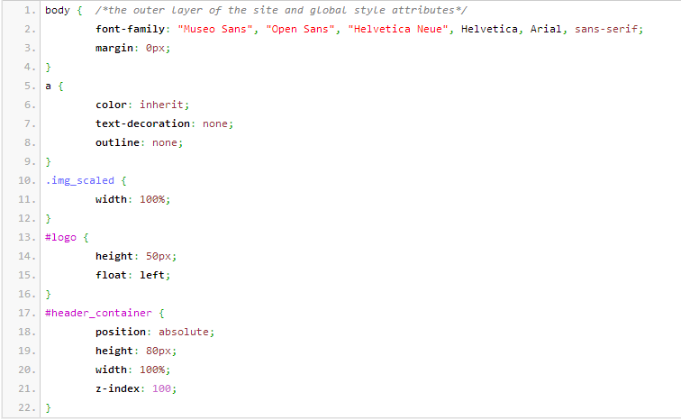
CSS Properties – Font Family

Slide 65
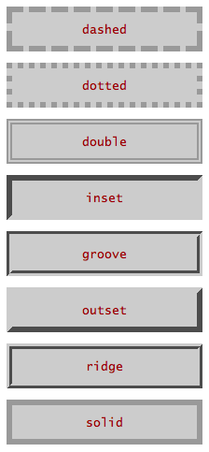
CSS Properties – Font Family
Lastly, there is border
border
Takes in 3 values, space-separated
1st value: border-width in px (pixels)
2nd value: border-style
3rd value: color
Example: border: 1px solid #999;
Thin solid gray border around your element

Slide 66
CSS Box Model

Slide 67
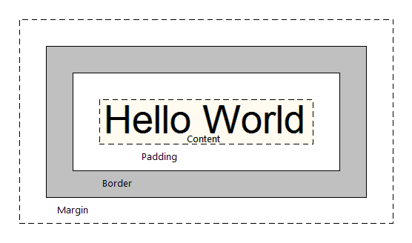
CSS Box Model
The CSS Box Model is the standard way of structuring your elements and web pages. It allows us to add space and borders to an element

Slide 68
CSS Box Model
Facebook makes use of the Box Model everywhere

Slide 69
CSS Box Model
4 Key components
Content
Padding
Border
Margin
Content is everything inside an element
Example: In <p>Hello World</p>, “Hello World” is the content
Border is the line that surrounds an element
Padding is the space between the content and border
Margin is the space from the border and nearby elements

Slide 70
CSS Box Model
We went over border last week
border
Takes 3 values: width, style, color
Example: border: 1px dashed blue;
Padding and Margin can take in 1, 2, 3 or 4 values
1 Value:
padding: 10px; = 10 pixels of space all around, from content to border
2 Values:
margin: 5px 10px; = 5 pixels of space above and below border, 10 pixels of space to the left and right of border
Corresponds to top & bottom, left & right

Slide 71
CSS Box Model
3 Values:
padding: 10px 5px 20px; = Corresponds to top, left & right, bottom
4 Values:
margin: 10px 5px 20px 15px; = Corresponds to top, right, bottom, left (clockwise)

Slide 72
CSS Box Model
Padding
Content
Border
Margin
Hello World!
In this example, a possible style for the element is:
padding: 15px;
border: 2px solid #ccc; /* light-gray */
margin: 5px 10px;

Slide 73
CSS Box Model
Padding
Content
Border
Margin
Hello World!
Also know that if you add a background-color to your image, it will color in the content and the padding portions of the element
Background-color will not affect the margin!!!

Slide 74
CSS Box Model
Currently we have divs that stack vertically. What does this mean?
Divs are, by default, blocks
They take up the entire row
By default, you cannot stack divs side by side
They look like this:

Slide 75
CSS Box Model
In order to stack horizontally, you must alter the CSS style for display
display
There are 3 important values for display: block, inline-block, inline
block
“block” displays respect all margins, paddings, height & width
Except, they have an auto-line break after it (next element goes directly below it)
inline-block
Exactly like a block but it has no line break after it
inline
Can have left & right margins/paddings, but no top & bottom ones. Also has no height/width. Allows elements next to them

Slide 76
CSS Box Model
Block Example
This has padding/margins.
Stacked vertically.

Slide 77
CSS Box Model
Inline-Block Example
Side by side
With margin/padding
And you can set the width/height

Slide 78
CSS Box Model
Inline Example (essentially a <span> tag)
No top/bottom
No height/width
But you can stack horizontally.
See?

Slide 79
CSS Box Model - Examples
Inline Example (essentially a <span> tag)
The quick brown fox jumps over the lazy dog.
<div>
The quick <span id=“bold”>brown fox</span> jumps over the lazy dog.
</div>

Slide 80
CSS Box Model - Examples
What happens if instead of <span>, you use <div>?
<div>
The quick <div id=“bold”>brown fox</div> jumps over the lazy dog.
</div>
The quick
brown fox
jumps over the lazy dog.

Slide 81
CSS Box Model - Examples
Now if add the CSS properties to id=“bold”:
display: inline-block & padding: 0 40px
<div>
The quick <div id=“bold”>brown fox</div> jumps over the lazy dog.
</div>
The quick brown fox jumps over the lazy dog.
You can add width, padding, and margins to your elements!
Amazing!

Slide 82
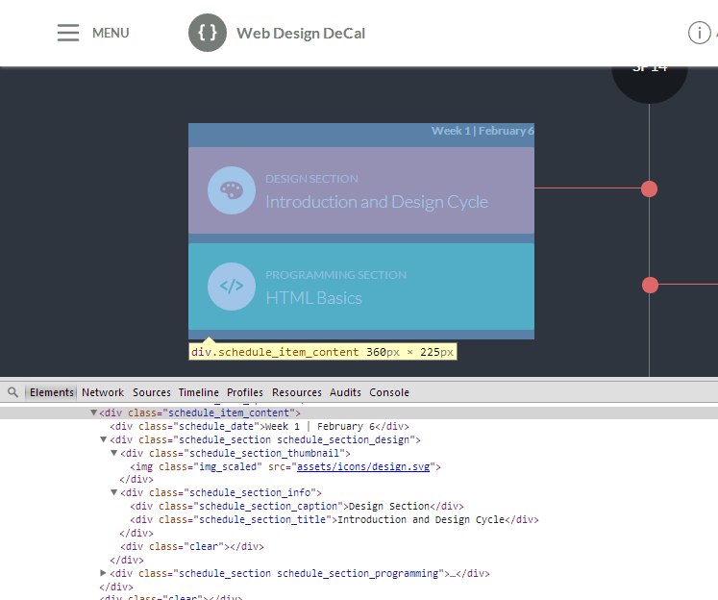
CSS Box Model

Slide 83
Centering a Div
Text or Div Element
Centering text is easy, use text-align: center
What if you want to center a <div> that has a certain width?
Center me! I want this box to be in the center! :)

Slide 84
Centering a Div
Text or Div Element
By default, if you give your <div> a width (say 200px), it will automatically be on the left
Center me! I want this box to be in the center! :)

Slide 85
Centering a Div
Text or Div Element
To center a <div>, add 2 CSS properties to the element:
margin-left: auto; margin-right: auto;
Margin-left and margin-right auto lets the browser place your element in the center of page, or center of the above element (if it is not <body>)

Slide 86
Centering an Image
Image
What about centering an image? (<img> tags)
Again, by default it is on the left

Slide 87
Centering an Image
Image
To center an image, like text, add margin-left/right to auto
Also, specifically add display: block

Slide 88
Centering an Image
Image
Remember that <div> elements by default are display: block
<img> tags by default are not display: block, so we must type in display: block manually, to tell the browser that the image takes up the entire row

Slide 89
CSS Color

Slide 90
CSS Color
Color is important for font colors, background colors, borders, etc.!
Color on the web can be represented in 3 ways:
A default color value
Hex Value
RGB Value
What do these mean?
Default Color
16 pre-defined CSS colors
Example: red, blue, black, white, maroon, etc.
Too limited may not be what you want!

Slide 91
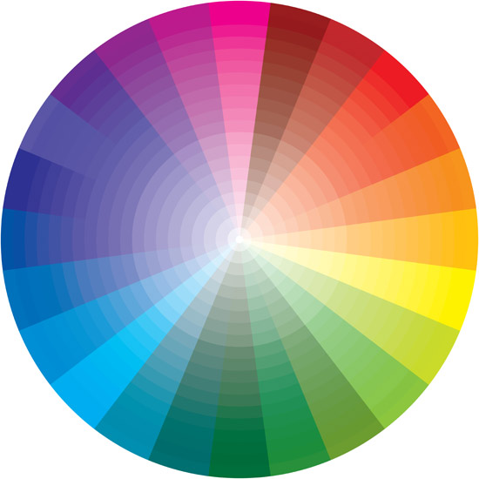
CSS Color
Hex Color (Hexadecimal)
Millions of ways to define a color!
Syntax: Pound sign # followed by 6 digits/characters from 0 to 9 and A to F
Example: #FF0000 (red), #339CCD (light blue), #888888 (gray)
0-9 & A-F = 16 possible values
16*16*16*16*16*16 = 16 Million Ways
To Define 1 Color!

Slide 92

CSS Color - Hex
Hex values are 6 digits, or 3 bytes
Each byte is 2 digits and represents a “color”
Red corresponds to the 1st byte, Green to the 2nd, Blue to the 3rd
A “0” indicates no color. Increasing the value to 1, 2, etc. increases the color. An “F” indicates full color (lightest)
Example: #0000FF
Equivalent to “no reds”, “no greens”, “full blues” = Pure Blue
What is “Purple”?
Answer: #FF00FF! It is a mix of pure red and pure blue. Other shades may include #AA00AA or #330033.

Slide 93
CSS Color - Hex
Screens and monitors are black by default
When you have #000000 (no color), this means you get black
When you have #FFFFFF (all colors), you get white
Thus, some red on a black surface = dark red: #330000
Another fun tip! If a color’s byte has 2 repeating digits (88, FF, 00), and all 3 bytes have repeating digits, you can do a shorthand by using the single digit
Example: #FF0000 → #F00
#CC88DD → #C8D
#000000 → #000

Slide 94
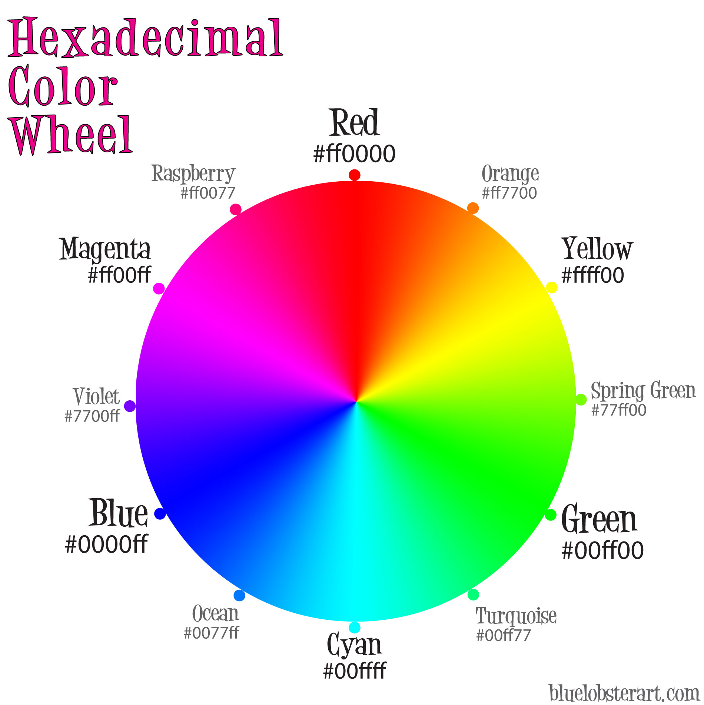
CSS Color - Hex

Slide 95
CSS Color - RGB
RGB colors
Syntax: rgb(255, 0, 0)
rgb(…) takes in 3 values: red, green, blue
Similar to Hex. 0 in rgb is 00 in hex, 255 in rgb is FF in hex
Examples:
rgb(255, 0, 0) vs. #FF0000
rgb(51, 156, 205) vs #339CCD
Which to use? RGB or Hex?
Hex is great, supported by all browsers
Hex is used excessively in Photoshop, Illustrator, etc.
Easy to memorize over digits

Slide 96
Hands-on Activity

Slide 97
CSS Positioning
4 types of positioning in CSS:
position: static
position: relative
position: absolute
position: fixed
By default, all your divs and elements are position: static

Slide 98
position: static
Default position, follows the natural flow of the page
Cannot use offsets: top, left, bottom, right

Slide 99
position: static
Use position: static (default behavior) to stack elements vertically

Slide 100
position: relative
Offsets element using position values (top, left, right, bottom)
Example: Set top to -10px, left to -10px

Slide 101
position: relative
Use position: relative to provide a reference point for elements inside this div that will be absolutely positioned.
Example: Set top to -10px, left to -10px

Slide 102
position: absolute
Element is moved relative to first non-static parent (default: top: 0, left: 0)
<div> is position
relative
<div> is position
absolute
Example: Set left to 10px, top to 5px

Slide 103
position: absolute
Element is moved relative to first non-static parent element
<div id=“container”>
<div id=“content”>
Hello World!
</div>
</div>
#container { position: relative; }
#content {
position: absolute;
top: 20px;
left: 20px;
}

Slide 104
position: absolute
If no non-static parent element found, move relative to <body>
<body>
<div id=“content”>
Hello World!
</div>
<body>
#content {
position: absolute;
top: 20px;
left: 20px;
}

Slide 105
position: absolute
Example of div relative to div relative to div (div-ception!!)
<div id=“container”>
<div id=“content”>
<div id=“inner-content”>Hello World!</div>
</div>
</div>
#container { position: relative; }
#content { position: absolute; top: 20px; left: 20px;}
#inner-content { position: absolute; top: 30px; left: 10px; }
#inner-content will be relative to #content
So in total, it is 50px from top of #container, 30px left of #container

Slide 106
position: absolute
<body>
<div id=“relative1”>
<div id=“relative2”>
<div id=“absolute1”> ….
What are possible top, right, bottom, left values for #absolute1?
#relative1
#relative2
#absolute1
<body>
#absolute1 is moved relative to #relative2.
So… bottom: 0, left: 5px (example)

Slide 107
position: absolute
<body>
<div id=“relative1”>
<div id=“absolute1”>
<div id=“relative2”> ….
What are possible top, right, bottom, left values for #absolute1?
#relative1
#relative2
#absolute1
<body>
#absolute1 is moved relative to #relative1.
So… top: 0, right: 0 (don’t even need to type px)

Slide 108
position: absolute
Use position: absolute to manually place an element to a desired location, or to place elements on top of each other.
<div> is position
relative
<div> is position
absolute
Example: Set left to 10px, top to 5px

Slide 109
Hands-on Session 3 Positioning Haven I

Slide 110
position: fixed
Element stays on the screen, even when scrolling. Positioned relative to browser window
<div> is position
fixed
Example: Set left to 10px, top to 5px

Slide 111
position: fixed
Element stays on the screen, even when scrolling. Positioned relative to browser window
<div> is position
fixed

Slide 112
Floats

Slide 113
Float
What is a float?
They allow your elements to be part of the flow on the page
Second <div>
One <div>

Slide 114
Float
If you made one div position: absolute…
Overlapping
Position: absolute
One <div>

Slide 115
Float
If you were to recreate the page with <div> elements set to display: inline-block…
Not efficient!

Slide 116
Float
float
2 properties
float: left
float: right
Even if an element is a <div> or has display: block, float will essentially bypass these properties and act like display: inline-block, but automatically floating left or floating right
The following element will be next to the floated <div>

Slide 117
Float
No floats, just <div>

Slide 118
Float
First box, float: left

Slide 119
Float
One Use Case: Menus
Home
About
Experiences
Contact

Slide 120
Float
Floating Menu Items (each with set width)
Home
About
Experiences
Contact
Notice no gaps!
If you use display: inline-block for these 4 elements:
Home
About
Experiences
Contact
display: inline-block produces gaps on the sides

Slide 121
Float
If you use display: inline-block for these 4 elements:
Home
About
Experiences
Contact
display: inline-block produces gaps on the sides
Work-around:
Add margin-right: -4px
Or…
Awkward! Use margin-right: -4px, or floats!
<div>Home</div
>About</div >Experiences</div
>Contact</div>
<div>Home</div><!--
--><div>About</div><!--
--><div>Experiences</div><!--
--><div>Contact</div>

Slide 122
CSS Clear
clear
clear: both
Individually, clear: left and clear: right
If one element floats left, the following element will appear beside it
Float has a tendency to continue stacking the next element – we usually don’t want this
Use clear: both after each series of horizontally stacked element via float.
Use clear: both for the following element to break the float, so it appears below the floating element

Slide 123
CSS Clear
First box, float: left

Slide 124
CSS Clear
Second box, using clear: both

Slide 125
CSS Clear
Tip: Create a class called .clear that you can use throughout your website!
.clear {clear: both}

Slide 126
Horizontal stacking
Home
About
Experiences
Contact
Give float: left to each of the horizontally stacked element
Add clear: both element at the very end
Think of clear:both as a period mark!
<div class=“menu-item”>Home</div>
<div class=“menu-item”>About<div>
<div class=“menu-item”>Experiences</div>
<div class=“menu-item”>Contact</div>
<div class=“clear”></div>

Slide 127
Hands-on Session 4 Positioning Haven II

Slide 128
CSS vertical centering
Unfortunately, vertical centering in CSS is not intuitive
You must carefully use position: absolute to make this work
Position: absolute
Top: 50%
Margin-top: - ((height of an element) / 2 ) px
Since CSS cannot compute by itself, you must calculate the negative margin on your own. (or via javascript – do it only if you have dynamic elements)

Slide 129
Divide and Conquer
Think about your website into individual components, and design them separately in order.
Remember:
Horizontal stacking – Floats
Vertical stacking – Does automatically
On top of each other – position absolute
Each individual component will be its own div
Master this and you can take “any design” into code!

Slide 130
Exercise
What should you design first?

Slide 131
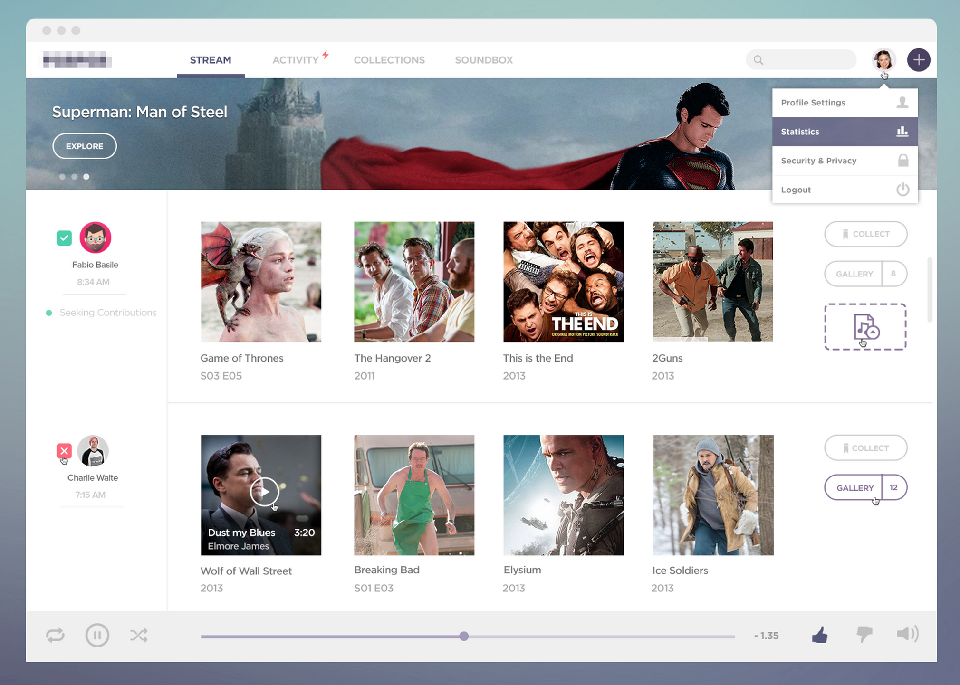

Slide 132
Structure
Logo
Navigation
Stream | Activity | Collections | Soundbox
Search
Search box | User | Add
Implementation
Horizontal => Floats

Slide 133
Structure
Cover
Content
Title
Explore
Some dots
Implementation
Cover (position: absolute)
Content (position: absolute)
Align vertically using divs

Slide 134
3 Parts: Sidebar, Gallery, Toolbar
A bit complicated if you think about making this responsive (viewable in multiple screen sizes)
Assume the size is fixed for this example only:
Horizontal stack => Floats

Slide 135
Sidebar
Thumbnail
Name
Date
Contribution
Content (4X)
Thumbnail
Title
Episode / Release Date
Toolbox
Collect
Gallery
Some music thing

Slide 136
Simple – just stack things vertically using divs
Horizontal stack => Floats

Slide 137
3 Parts: Controls, Progress Bar, Options
Horizontal stack => Floats
Controls (Horizontal stack => Floats)
Repeat
Play
Shuffle
Progress bar
Options (Horizontal stack => Floats)
Like
Dislike
Volume

Slide 138
Hands-on Session 5 Positioning Haven III

Slide 139
Intro to JavaScript

Slide 140
Intro to JavaScript
JavaScript is the scripting language of the web
Not the same as Java!
Like CSS, you can select elements and manipulate their actions
Hide/Unhide menus
Photo Slider (carousel)
Popup modals (like Facebook’s Photo Viewer)
Form Validation
One-Scroll Homepage

Slide 141
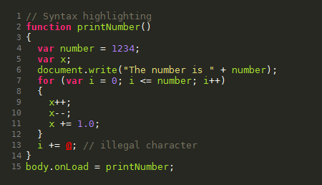
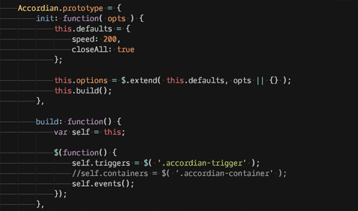
Intro to JavaScript
Sample JavaScript:

Slide 142
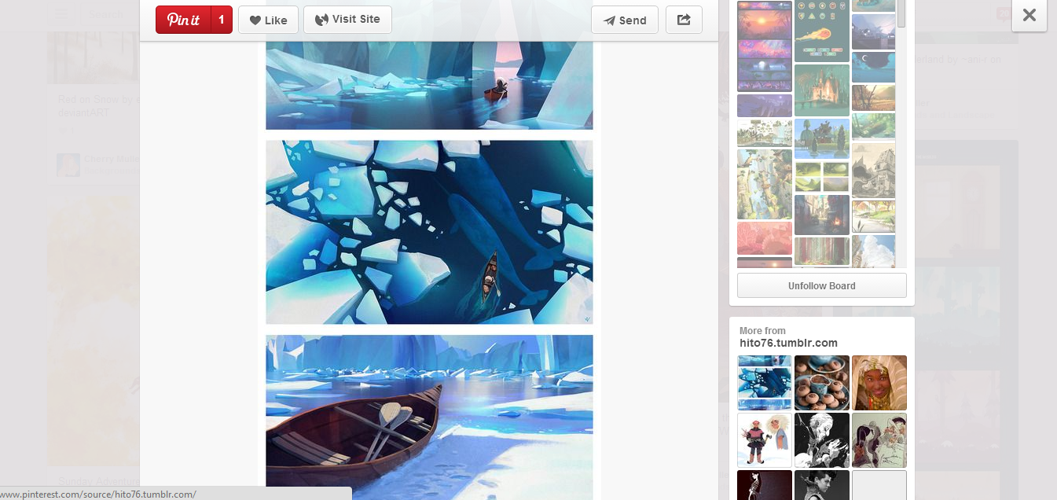
Intro to JavaScript - Examples
Pinterest - Modals

Slide 143
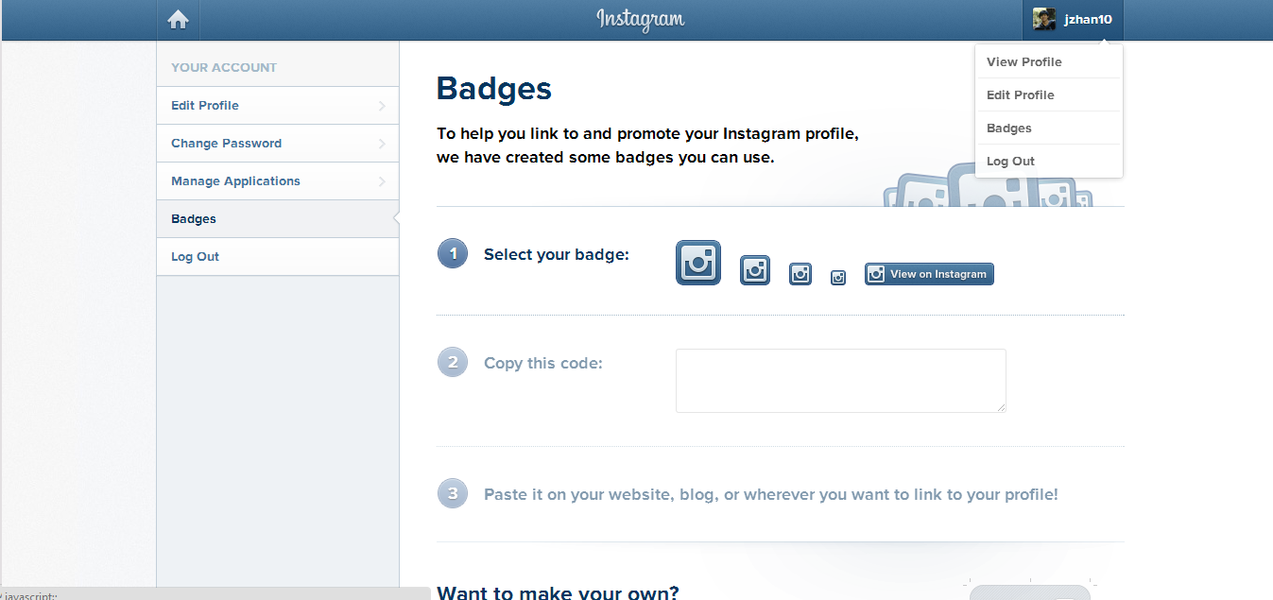
Intro to JavaScript - Examples
Instagram - Toggling Menus

Slide 144
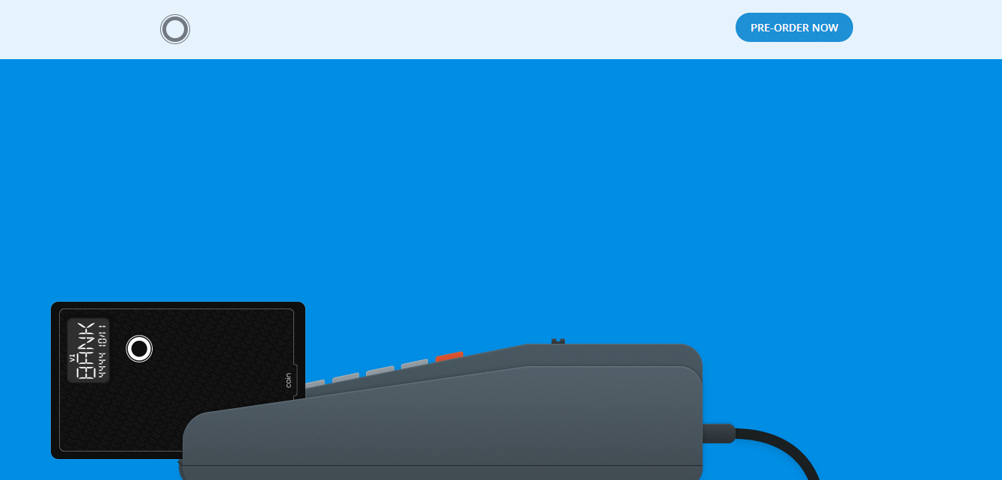
Intro to JavaScript - Examples
Coin – JavaScript animations while scrolling

Slide 145
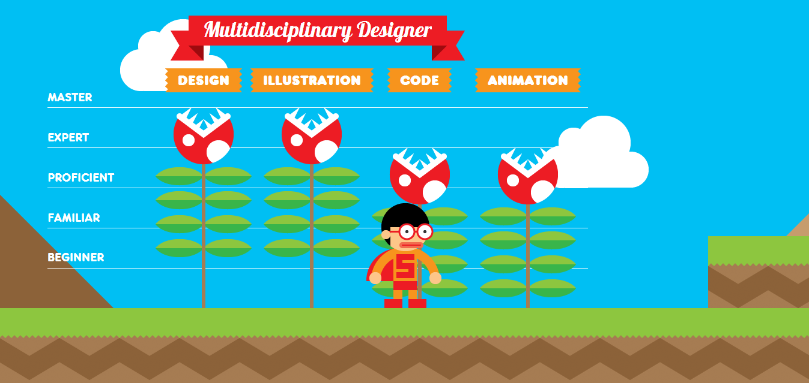
Intro to JavaScript - Examples
Interactive Resume (http://www.rleonardi.com/interactive-resume/)

Slide 146

Intro to JavaScript - Examples
GameTrailers – Photo Slider

Slide 147
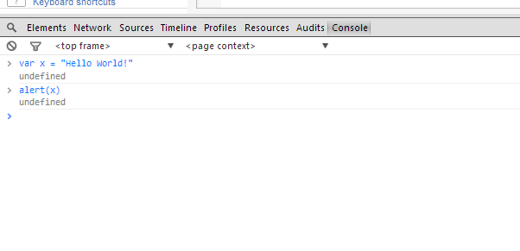

Intro to JavaScript
How to you use Javascript?
Like CSS, you link to a separate .js file that contains your file
<script type=“text/javascript” src=“home.js”></script>
You can also test JavaScript in Chrome’s console (Inspector Element window) and on JSFiddle.net
Let’s start coding!

Slide 148
Basic Syntax
Variables
They take in numbers, text, booleans (true/false) and functions
var x = 8;
var y = “John”
var z = ‘Smith’
var a = true;
Text (in computer science, we call them “strings”) can be surrounded by single or double quotes
Concatenation
You can add numbers or combine “strings”
var a = x + x;
var b = y + “ “ + z;
var c = 5 + “ five”;
“a” now stores 16. “b” stores John Smith.
Note: only use “var” to initialize (if the variable name has never been used before)

Slide 149
Basic Syntax
Shorthand increment/decrement
var x = 1;
x = x + 1;
// x is now 2
x += 1;
// x is now 3
x++;
// x is now 4
x--;
// x is now 3
To increment by 1, there are 3 ways:
1) x = x+1
2) x += 1
3) x++
Same goes for decrementing

Slide 150
Conditionals
If… Else…
If something do this, else do that
If(x > 9000) {
alert(“Over 9000!”);
} else {
console.log(“Weak”);
}
alert(…) is a JavaScript function that creates a popup.
console.log(…) outputs whatever is inside onto the console (e.g. Chrome’s console).
Both useful for debugging.
Plain If, and If…Else If… Else If…
if(z < 9000) {
alert(“Not Saiyan”);
}
if(z == 1000) {
…
} else if (z == 2000) {
…

Slide 151
Conditionals
Comparisons
<, >, >=, <=
== and === (3 equal signs checks value and type)
var x = 3;
x == 3 // true
x === “3” // false
x === 3 // true
And/Or - &&/||
if((x==3) && (y==5)) {
…
if(x || y) {
….

Slide 152
Conditionals
Not Equal - !=, !== (not same type too)
if(x != y) {
…
}
Remember, you can use ( ) parentheses to separate your logic. (e.g. if((x != 3) && (y != 4)) )

Slide 153
Arrays
Variables can also store more than 1 value
var x = new Array(“Porsche”, “BMW”, “Ferrari”);
or
var x = [“Porsche”, “BMW”, “Ferrari”];
or
var x = new Array();
x[0] = “Porsche”;
x[1] = “BMW”;
x[2] = “Ferrari”;

Slide 154
Arrays
Access an array with […]
First value is always the array position. Positions start at 0
var x = [“Porsche”, “BMW”, “Ferrari”];
alert(x[0]); // Will alert “Porsche”
Set values for an array
x[2] = “Tesla”;
You can get an array’s length with arrayname.length
x.length // returns 3. However, max position is 2, since we start at 0

Slide 155
Loops
For Loop
Loop through items/arrays
3 components
for(var i=0; i < 10; i++)
1st value initializes variable. i++ increments i by 1 after loop is complete. Loop while i < 10, and stop when condition is not met.
var cars = [“Porsche”, “BMW”, “Tesla”];
for(var i = 0; i < cars.length; i++) {
alert(cars[i]);
}
// alerts each value in cars, one by one

Slide 156
Loops
While Loop
Loop through items/arrays
1 component
while(i < 30) { … }
Initialize (var i = 0) before while loop, increment (i++) inside
var i = 0;
while(i < 30){
alert(i);
i++;
}
// alerts values 0 to 29
Warning!
If you don’t increment, or don’t fail the conditional statement at some point, you end up in a never-ending loop! Not good!

Slide 157
Loops
For vs. While
For loops are more compact
But while loops are fast to type
for(var i=0; i<100; i++) {
alert(i);
}
var i = 0;
while(i < 100) {
alert(i);
i++
}
Output: 0, 1, 2, … , 98, 99

Slide 158
Functions
Functions are a set of JavaScript code, that can perform some action, return a result, or do computation
They take in 0 or more arguments (values to be passed in)
Arguments are by default type var, so arr can be any var
function printOddValues(arr) {
var odd = true;
for(var i=0; i<arr.length; i++) {
if(odd){
console.log(arr[i]+” “);
odd = false;
} else {
odd = true;
}
}
}
Once you have a function, you can call it!
var arr = [1, 2, 3, 4, 5, 6, 7];
printOddValues(arr);
Output: 1 3 5 7
var arr = [“OH”, “CA”, “PA”, “NY”];
printOddValues(arr);
Output: OH PA

Slide 159
Functions
Functions can return values, and you can save them in a variable (for future use)
function calculateExp(value, times) {
if(times < 0) {
return -1;
} else if(times == 0) {
return 1;
} else {
var count = 1, total = 0;
while(count <= times) {
total += value;
}
return value;
}
}
Let’s call this function!
var x = calculateExp(5, 3);
alert(x);
Output: 125
var x = calculateTimes(10, -999);
if(x != -1){
alert(“No neg nums please”);
}
Output: “No neg nums please”

Slide 160

JavaScript
Functions and variables are cool… but can we do more with JavaScript?
jQuery, a JavaScript library, comes in handy!
jQuery allows you to access HTML elements and do all sort of things!
Click events
Keyboard presses
Scrolling animations
Modal popups
Toggling menus
Smoother hovers and animations
Etc.

Slide 161
Intro to jQuery

Slide 162

jQuery
Functions and variables are cool… but can we do more with JavaScript?
jQuery, a JavaScript library, comes in handy!
jQuery allows you to access HTML elements and do all sort of things!
Click events
Keyboard presses
Scrolling animations
Modal popups
Toggling menus
Smoother hovers and animations
Etc.

Slide 163
jQuery
How do we add jQuery to our page?
Either insert the first element below, or download the jQuery .js file and link to it
Important! Add this before any links to your own .js files!
<script src="http://code.jquery.com/jquery-1.11.0.min.js"></script>
Above: Link to an online copy of jQuery
<script src=“assets/js/jquery-1.11.0.min.js"></script>
Above: Link to a local copy of jQuery

Slide 164
jQuery
Selectors & Accessing Content

Slide 165
jQuery - Selectors
To use jQuery, you have to access HTML elements first
Syntax
$(selector) – The $ tells the browser this is jQuery
Replace selector with the CSS selector in quotes (single or double)
$(‘body’)
$(‘.box’)
$(‘#container .box’)
$(‘a’)
Like in CSS, we must select elements before we can apply actions to them
Once you select an element, you can access different values, properties, or functions to the element

Slide 166
jQuery – Accessing Content
3 common ways to access element content
.text() – Grabs all text inside an element
.html() – Grabs all HTML inside an element
.val() – Grabs the value attribute or an element (useful for inputs)
<div id=“box”>
<div class=“title”>
Hello World!
</div>
</div>
$(‘#box”).text() → Hello World!
$(‘#box”).html() →
<div class=“title”>Hello World!</div>
You could test the above using console.log($(‘#box’).text()) or alert($(‘#box’).html());

Slide 167
jQuery – Accessing Content
.val()
Useful to get search results, form input, etc.
<input type=“text” id=“name”>
$(‘#name”).val() → Jeff
Jeff

Slide 168
jQuery – Setting Content
Likewise, you can set content
$(‘#box’).html(‘<p>New Title</p>’);
$(‘#email’).val(‘sample@example.com’);

Slide 169
jQuery
Accessing content, or setting content is useful!
But how so? When should we access an element’s value? Or HTML? Or text?
When using Events (actions user does)
E.g. Click a button to replace the HTML on a page
Hit enter to get User’s Login information
Scroll down page and change CSS

Slide 170
jQuery Events

Slide 171
jQuery – Event Listeners
Event Listeners are always on the page, “listening” for an event to occur (and react to these events)
Events include:
Clicking
Key presses
Scrolling
Hovering (smoother than CSS, more powerful)
Tons more

Slide 172
jQuery – Event Listeners
Event Listeners are attached to jQuery selected elements
E.g. $(‘#box’).click(function() { … });
Syntax:
.click(function(){ … });
.hover(function(){ … });
.scroll(function(){ … });
Always pass a function to an event listener! (event handlers)
$(‘#box’).click(function(){
alert(“You are so cool.”);
});
Browser binds click event to #box. It continues to “listen” as user is on page, and when user clicks on #box, a popup will appear!

Slide 173
jQuery – Event Listeners
More examples
$(‘#box’).hover(function(){
alert($(this).html());
});
Inside your event listener function, you can refer to the current element (say #box) with simply $(this).
$(‘.box’).hover(function(){
alert($(this).html());
});
This hover now applies to all class box. $(this) only refers to the element you hovered on, not to all elements with class box!
$(‘.box’).click(function(){
$(‘.box2’).hide();
});
Don’t have to use $(this)!
Here, we click on any element with class .box, and you hide all elements with class .box2

Slide 174
jQuery Effects

Slide 175
jQuery – Effects
You have seen ways to access content
.html(), .text(), .value()
You have seen events
.click(), .hover(), .scroll()
Let’s talk about effects
Hiding elements
Showing elements
Fade In, Fade Out
Sliding up, Sliding Down

Slide 176
jQuery – Effects
.show(), .hide()
Extremely useful and common
Essentially just adds/removes the CSS property display: none to an element
$(‘#menu-show’).click(function(){
$(‘#menu’).show();
});
$(‘#menu-hide’).click(function(){
$(‘#menu’).hide();
});

Slide 177
jQuery – Effects
.fadeIn(time), .fadeOut(time)
Like show() and hide(), but gradually fading
Time takes in milliseconds. 1000 is a second
$(‘#menu-show’).click(function(){
$(‘#menu’).fadeIn(500);
});
$(‘#menu-hide’).click(function(){
$(‘#menu’).fadeOut(500);
});

Slide 178
jQuery – Effects
.slideUp(time), .slideDown(time)
Like fadeIn() and fadeOut(), but height changes over time
Again, time in milliseconds
$(‘#menu-show’).click(function(){
$(‘#menu’).slideDown(500);
});
$(‘#menu-hide’).click(function(){
$(‘#menu’).slideUp(500);
});

Slide 179
jQuery – Effects
.css(style, value)
Change the CSS
Ex: $(‘body’).css(‘color’, ‘red’);
$(‘#menu’).click(function(){
$(this).css(‘background’, ‘#333’);
});

Slide 180
jQuery Initialization

Slide 181
jQuery - Initializing
Initializing jQuery
So you added the <script … ></script> for jQuery
Now, before we can do anything, you must let the browser know you are using jQuery in your JavaScript files
Start your .js files with:
$(document).ready(function(){
… your javascript here …
});
$ - Calls the jQuery library
(document) – Selects the entire HTML page
.ready – When all the HTML is loaded…
function(){ … } – …do everything inside this function

Slide 182
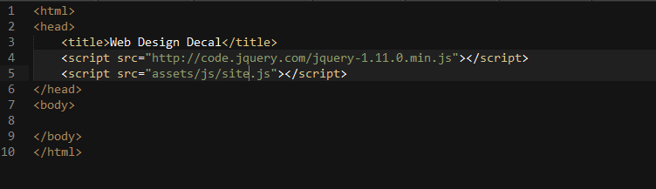
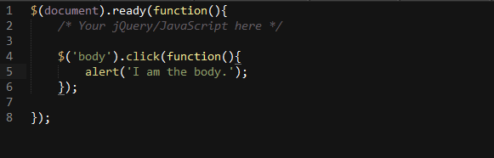
jQuery
Your HTML
Your Linked JavaScript File (assets/js/site.js)

Slide 183
Hands-On Activity

